Slide 1


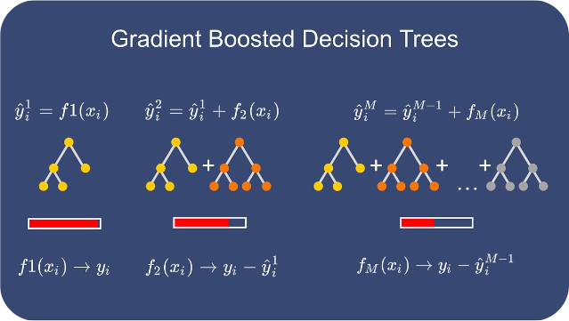
Gradient Boosting
Gradient Boosting is an ensemble learning technique that builds a strong predictive model by combining multiple weak learners in an iterative fashion. It works by sequentially adding new models that focus on correcting the errors of the previous models, gradually improving the overall performance.

Slide 2
Ensemble Learning and Weak Learners
Ensemble Learning
Weak Learners
Iterative Improvement
Gradient Boosting is a type of ensemble learning, which combines multiple models to achieve better performance than any individual model.
Gradient Boosting uses weak learners, such as decision trees, as the building blocks to construct a stronger, more accurate model.
By adding new weak learners that focus on correcting the errors of the previous models, Gradient Boosting iteratively improves the overall prediction.

Slide 3

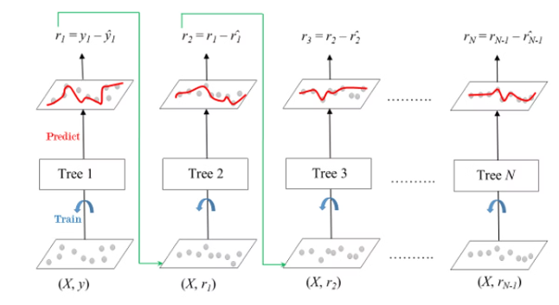
Gradient Boosting Algorithm
1
Step 1
Start with a basic weak learner, such as a decision tree with a single split.
2
Step 2
Compute the residuals (errors) between the current model's predictions and the true target values.
3
Step 3
Train a new weak learner to predict the residuals and add it to the ensemble.

Slide 4

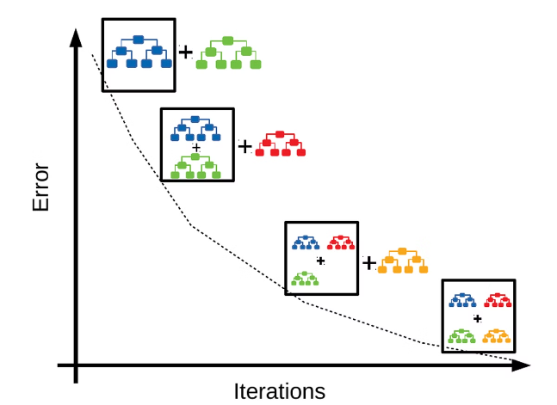



Minimizing Errors through Iterative Adjustments
Residual Computation
Calculate the errors between the current model's predictions and the true target values.
Model Adjustment
Train a new weak learner to predict the residuals and add it to the ensemble.
Error Reduction
The new model reduces the overall error, improving the ensemble's predictive performance.

Slide 5

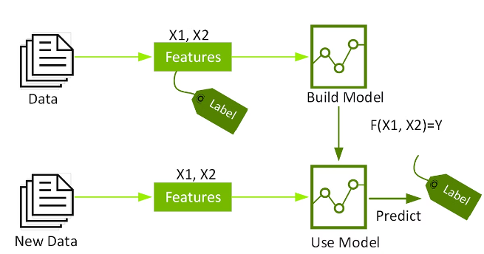
Advantages of Gradient Boosting
1
High Accuracy
Gradient Boosting can achieve state-of-the-art performance on a wide range of machine learning problems.
2
Robustness
It is resilient to outliers and can handle both numerical and categorical features.
3
Interpretability
The individual weak learners in the ensemble can provide insights into the underlying patterns in the data.
4
Versatility
Gradient Boosting can be applied to classification, regression, and ranking tasks.

Slide 6

Hyperparameter Tuning for Gradient Boosting
Learning Rate
Maximum Depth
Determines the contribution of each new weak learner to the ensemble. A lower rate can lead to better generalization.
Controls the complexity of the individual weak learners. Deeper trees can capture more complex patterns.
Number of Estimators
Regularization
Specifies the number of weak learners to be added to the ensemble. More estimators can improve performance.
Techniques such as L1 or L2 regularization can help prevent overfitting.

Slide 7


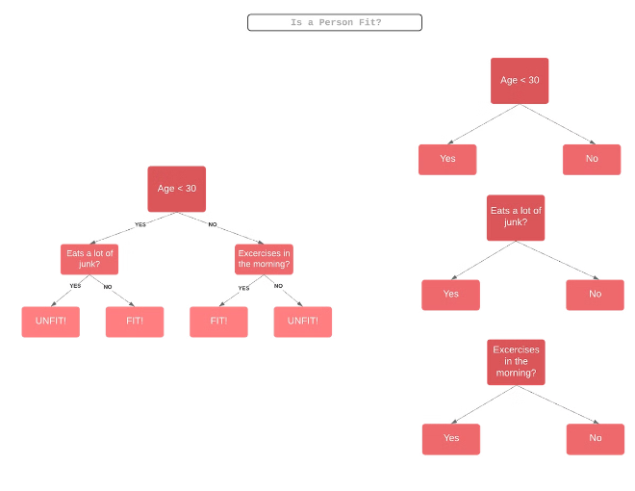

Applications of Gradient Boosting
Classification
Gradient Boosting is widely used for classification tasks, such as spam detection, sentiment analysis, and credit risk assessment.
Regression
It is also effective for regression problems, including stock price prediction, sales forecasting, and energy demand forecasting.
Ranking
Gradient Boosting algorithms can be used for ranking tasks, such as search engine result ranking and recommendation systems.

Slide 8

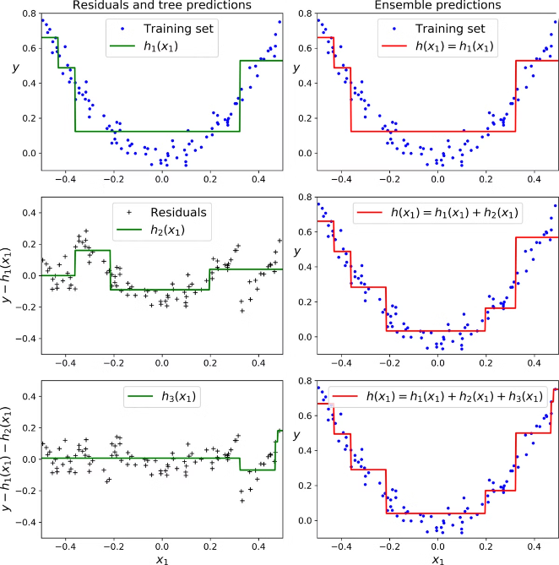
Conclusion and Key Takeaways
1
Ensemble Learning
Gradient Boosting is a powerful ensemble learning technique that combines multiple weak learners to create a strong predictive model.
2
Iterative Improvement
The algorithm iteratively adjusts the model by training new weak learners to correct the errors of the previous models.
3
Versatility and Performance
Gradient Boosting can be applied to a wide range of machine learning tasks and has been shown to deliver state-of-the-art performance.
4
Hyperparameter Tuning
Careful selection of hyperparameters, such as learning rate and maximum depth, is crucial for optimizing the performance of Gradient Boosting models.

